Slide 1
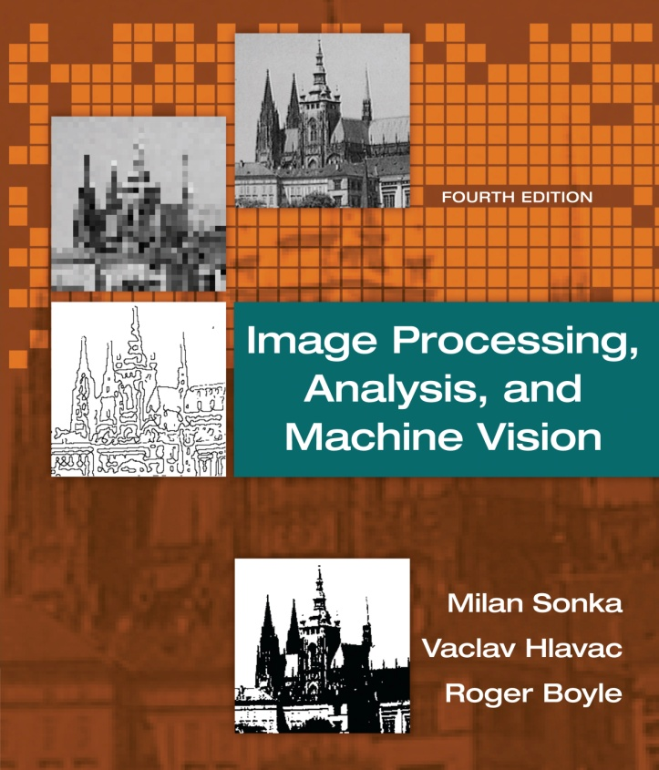

Chapter 6
Image Processing, Analysis, and Machine Vision, 4th Edition Sonka, Hlavac & Boyle
Segmentation I

Slide 2
Segmentation
Thresholding
Edge-based segmentation
Region-based segmentation
Matching
Evaluation issues in segmentation
Supervised evaluation
Unsupervised evaluation

Slide 3
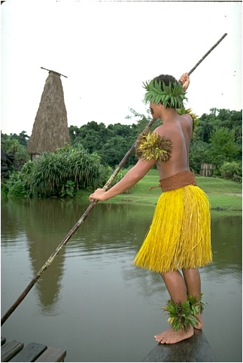
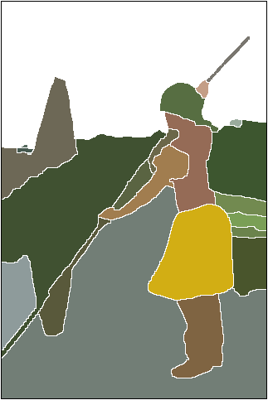
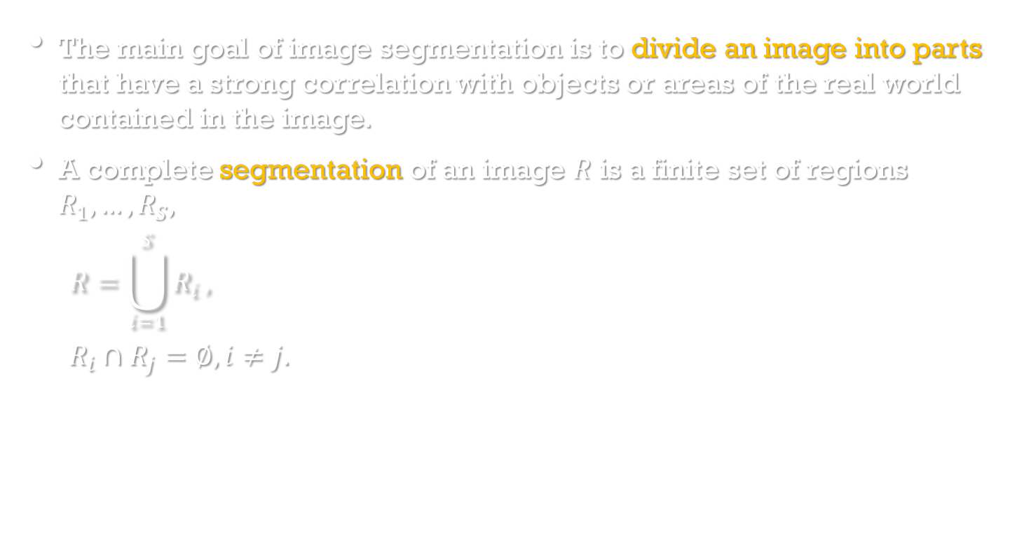
Segmentation
The main goal of image segmentation is to divide an image into parts that have a strong correlation with objects or areas of the real world contained in the image.
A complete segmentation of an image $R$ is a finite set of regions $R_{1},…,R_{S},$
$$R=\bigcup_{i=1}^{S}{R_{i}},$$
$$R_{i}∩R_{j}=∅, i≠j.$$
https://www2.eecs.berkeley.edu/Research/Projects/CS/vision/grouping/resources.html

Slide 4
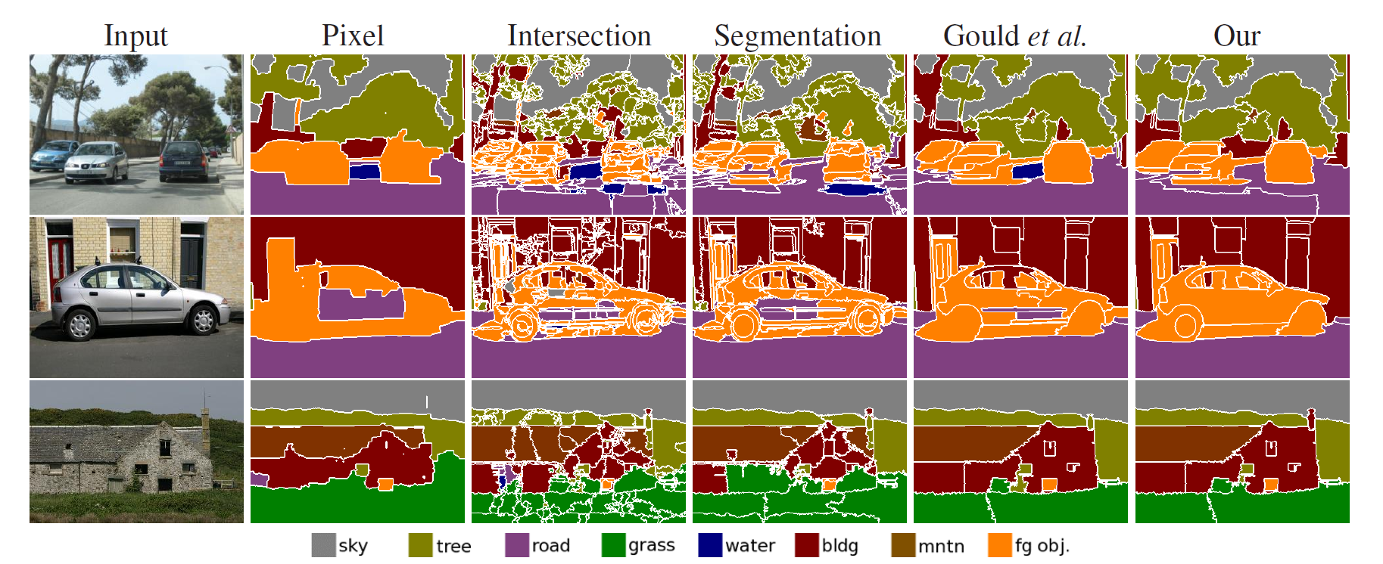
Segmentation
http://mpawankumar.info/research/region-selection.html

Slide 5
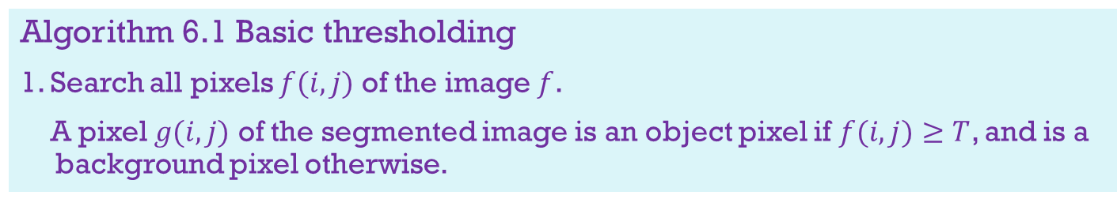
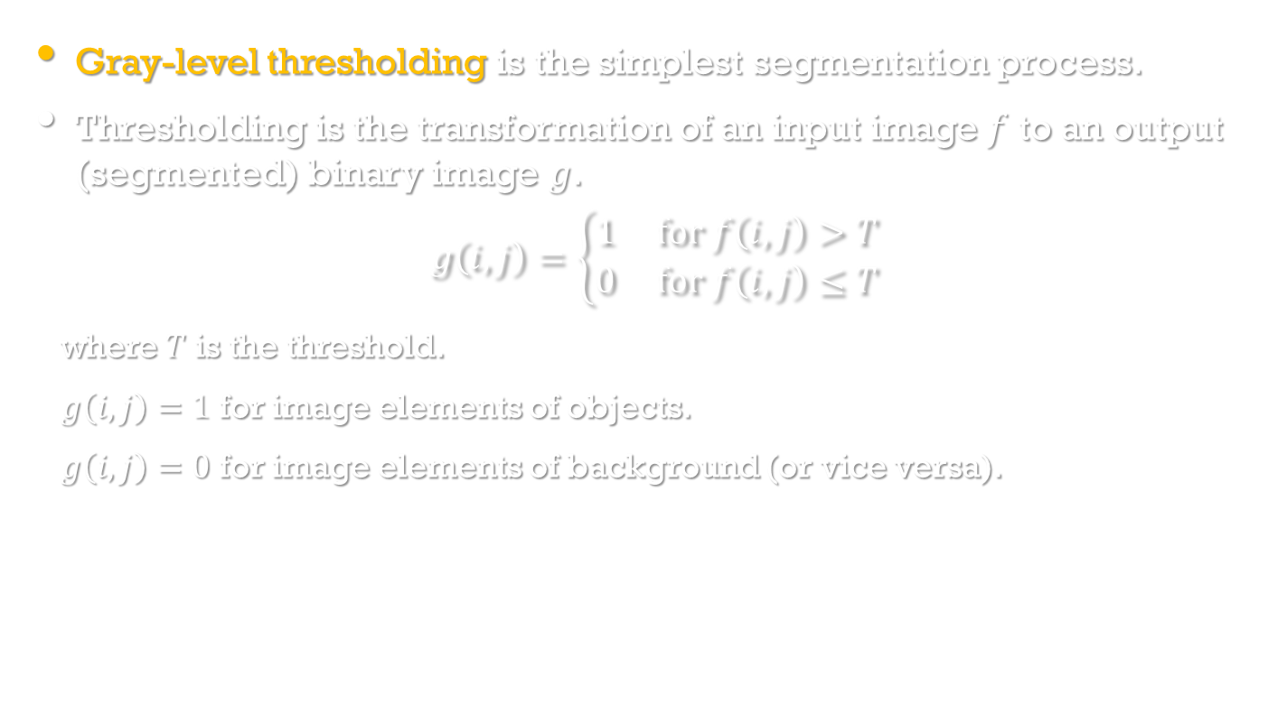
Thresholding
Image Processing, Analysis, and Machine Vision, 4th Edition Sonka, Hlavac & Boyle
Gray-level thresholding is the simplest segmentation process.
Thresholding is the transformation of an input image $f$ to an output (segmented) binary image $g$.
$$g\left(i,j\right)=\left\{\begin{matrix}1 for f\left(i,j\right)>T \\ 0 for f\left(i,j\right)≤T\end{matrix}\right.$$
where $T$ is the threshold.
$g\left(i,j\right)=1$ for image elements of objects.
$g\left(i,j\right)=0$ for image elements of background (or vice versa).
Algorithm 6.1 Basic thresholding
1. Search all pixels $f(i,j)$ of the image $f$.
A pixel $g(i,j)$ of the segmented image is an object pixel if $f(i,j)≥T$, and is a background pixel otherwise.

Slide 6
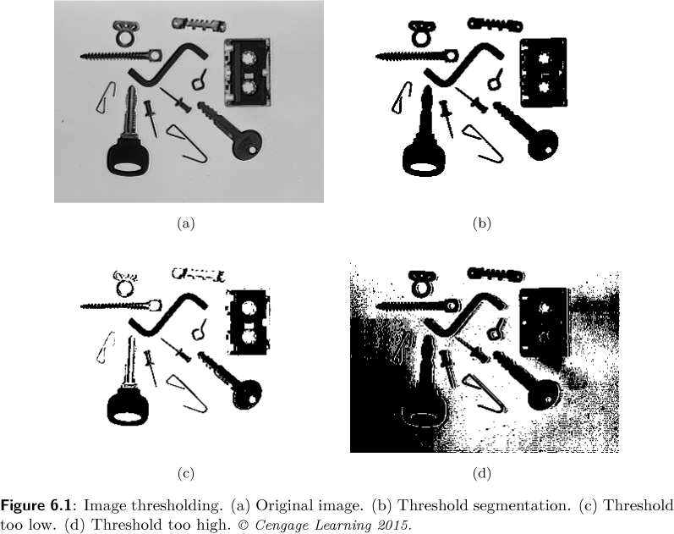
Thresholding
Image Processing, Analysis, and Machine Vision, 4th Edition Sonka, Hlavac & Boyle

Slide 7
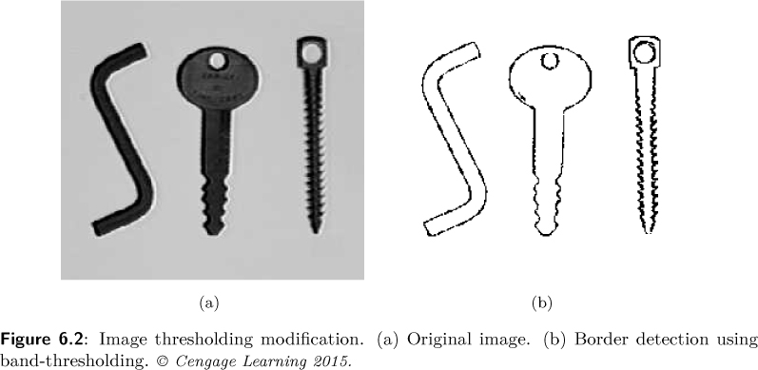
Thresholding
Image Processing, Analysis, and Machine Vision, 4th Edition Sonka, Hlavac & Boyle
Modifications of thresholding
Band thresholding
Object-border thresholding
Multi-thresholding
Using multiple thresholds

Slide 8
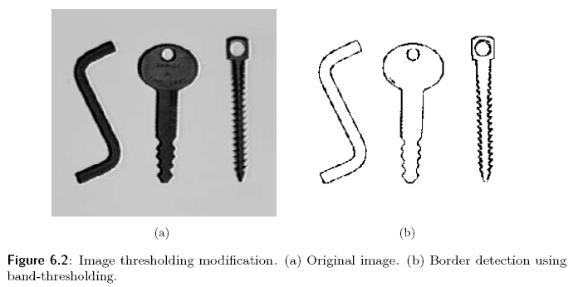
(A) Band Thresholding
D: a set of gray values
(B) Multiple Thresholding
(C) Semi-thresholding
8

Slide 9

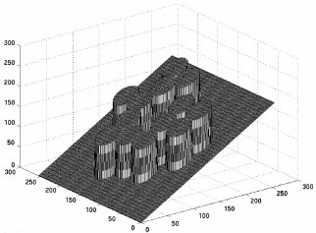
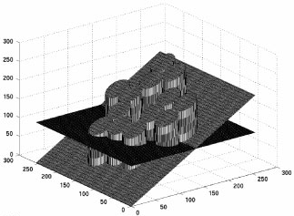



(D) Adaptive Thresholding
-- Threshold values vary over the image as a
function of local image characteristics
(ii) Apply global threshold
method to each strip
(i) Divide image into strips
9

Slide 10
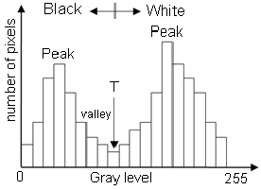
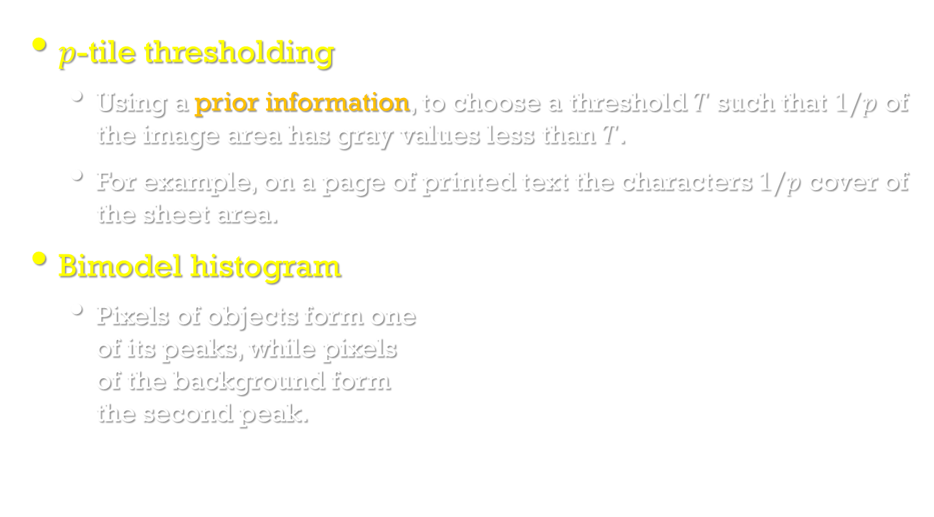
Threshold detection methods
Image Processing, Analysis, and Machine Vision, 4th Edition Sonka, Hlavac & Boyle
$p$-tile thresholding
Using a prior information, to choose a threshold $T$ such that $1/p$ of the image area has gray values less than $T$.
For example, on a page of printed text the characters $1/p$ cover of the sheet area.
Bimodel histogram
Pixels of objects form one of its peaks, while pixels of the background form the second peak.
https://www.researchgate.net/figure/233814424_fig1_Figure-1-Histogram-of-a-sample-gray-level-bimodal-image-T-is-the-threshold-value

Slide 11
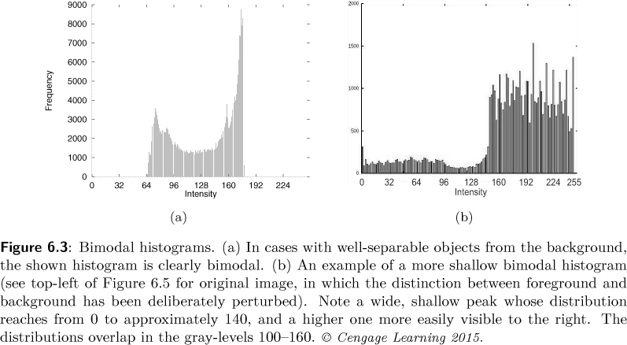
Threshold detection methods
Image Processing, Analysis, and Machine Vision, 4th Edition Sonka, Hlavac & Boyle
See Figure 6.5 (p.184)

Slide 12
Optimal thresholding
Image Processing, Analysis, and Machine Vision, 4th Edition Sonka, Hlavac & Boyle
Optimal thresholding
To model the histogram of an image using a weighted sum of two or more probability densities with normal distribution.
The threshold is set as the gray-level closest to the minimum probability between the maxima of the normal distributions, which results in minimum error segmentation.
Otsu’s algorithm
To test each possible threshold, and to compute the gray-level variances of both foreground and background each one implies.
The threshold is at the place where a weighted sum of these variances is minimal.

Slide 13
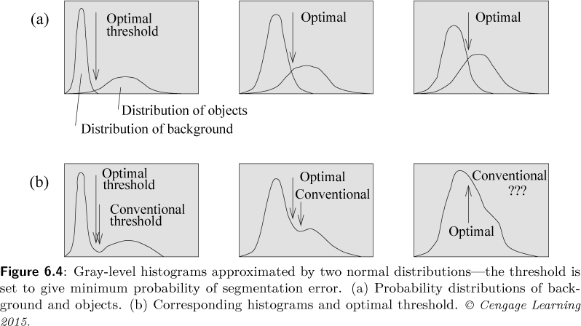
Optimal thresholding
Image Processing, Analysis, and Machine Vision, 4th Edition Sonka, Hlavac & Boyle

Slide 14
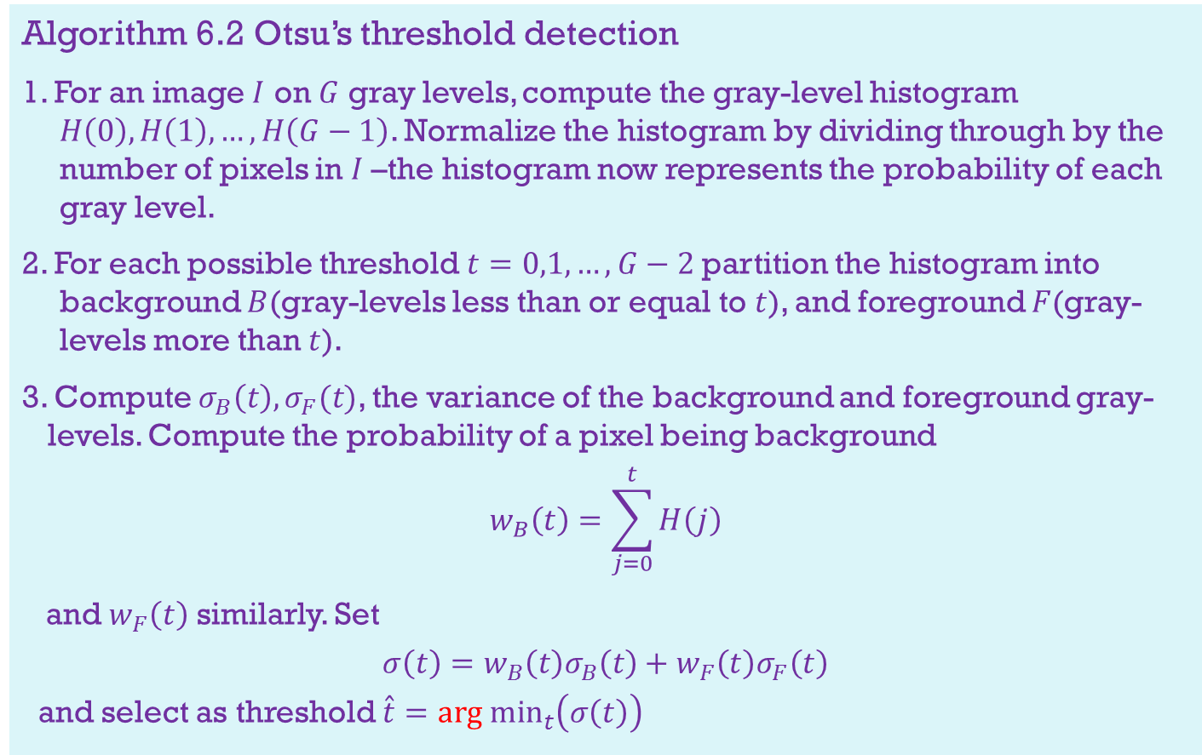
Image Processing, Analysis, and Machine Vision, 4th Edition Sonka, Hlavac & Boyle
Algorithm 6.2 Otsu’s threshold detection
1. For an image $I$ on $G$ gray levels, compute the gray-level histogram $H\left(0\right),H\left(1\right),…,H\left(G−1\right)$. Normalize the histogram by dividing through by the number of pixels in $I$–the histogram now represents the probability of each gray level.
2. For each possible threshold $t=0,1,…,G−2$partition the histogram into background $B$(gray-levels less than or equal to $t$), and foreground $F$(gray-levels more than $t$).
3. Compute $σ_{B}\left(t\right),σ_{F}(t)$, the variance of the background and foreground gray-levels. Compute the probability of a pixel being background
$$w_{B}\left(t\right)=\sum_{j=0}^{t}{H\left(j\right)}$$
and $w_{F}\left(t\right)$ similarly. Set
$$σ\left(t\right)=w_{B}\left(t\right)σ_{B}\left(t\right)+w_{F}\left(t\right)σ_{F}\left(t\right)$$
and select as threshold $\hat{t}={arg min}_{t}\left(σ\left(t\right)\right)$

Slide 15
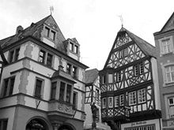
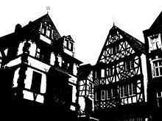
Otsu’s threshold detection
https://en.wikipedia.org/wiki/Otsu%27s_method

Slide 16
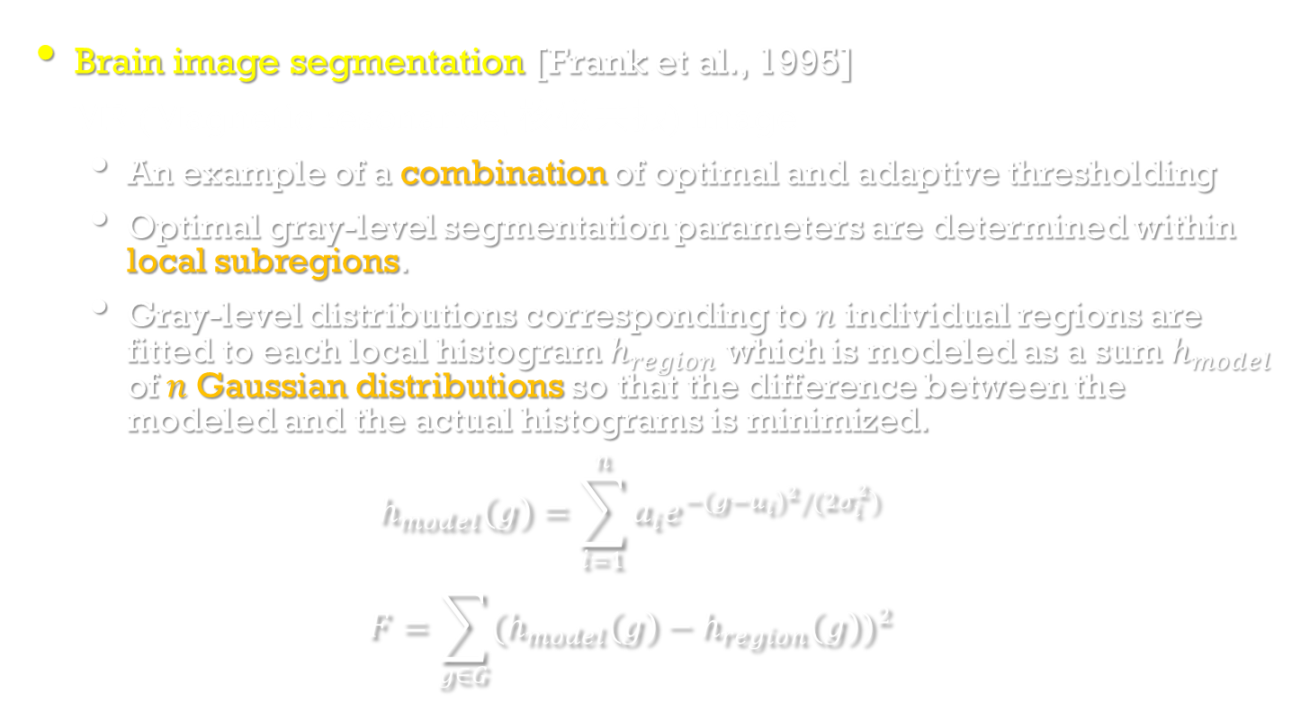
Optimal thresholding
Image Processing, Analysis, and Machine Vision, 4th Edition Sonka, Hlavac & Boyle
Brain image segmentation [Frank et al., 1995]
MR (Magnetic resonance; 核磁共振) image
An example of a combination of optimal and adaptive thresholding
Optimal gray-level segmentation parameters are determined within local subregions.
Gray-level distributions corresponding to $n$ individual regions are fitted to each local histogram $h_{region}$ which is modeled as a sum $h_{model}$ of $n$ Gaussian distributions so that the difference between the modeled and the actual histograms is minimized.
$$h_{model}\left(g\right)=\sum_{i=1}^{n}{a_{i}e^{−{\left(g−u_{i}\right)}^{2}/(2σ_{i}^{2})}}$$
$$F=\sum_{g∈G}{{(h_{model}\left(g\right)−h_{region}\left(g\right))}^{2}}$$

Slide 17
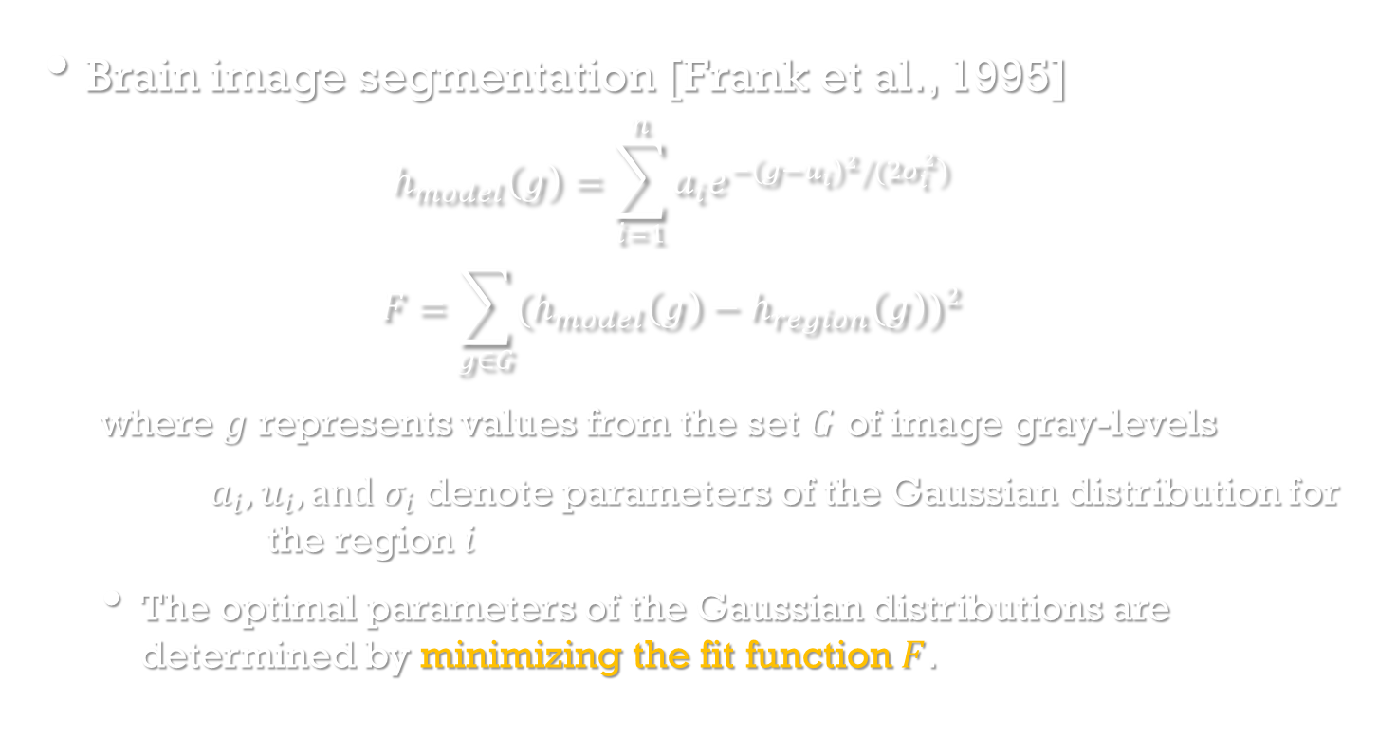
Optimal thresholding
Image Processing, Analysis, and Machine Vision, 4th Edition Sonka, Hlavac & Boyle
Brain image segmentation [Frank et al., 1995]
$$h_{model}\left(g\right)=\sum_{i=1}^{n}{a_{i}e^{−{\left(g−u_{i}\right)}^{2}/(2σ_{i}^{2})}}$$
$$F=\sum_{g∈G}{{(h_{model}\left(g\right)−h_{region}\left(g\right))}^{2}}$$
where $g$ represents values from the set $G$ of image gray-levels
$a_{i},u_{i}, and σ_{i}$ denote parameters of the Gaussian distribution for the region $i$
The optimal parameters of the Gaussian distributions are determined by minimizing the fit function $F$.

Slide 18
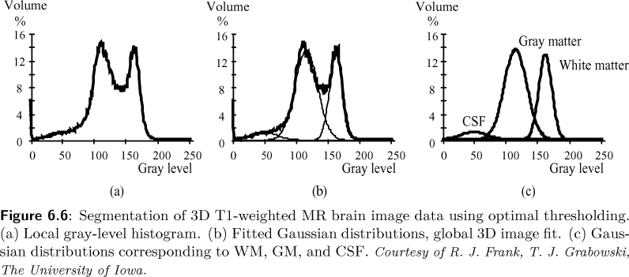
Optimal thresholding
Image Processing, Analysis, and Machine Vision, 4th Edition Sonka, Hlavac & Boyle
An example of brain image segmentation
WM: white matter (白質); GM: gray matter (灰質);
CSF: cerebrospinal fluid (腦脊液)

Slide 19
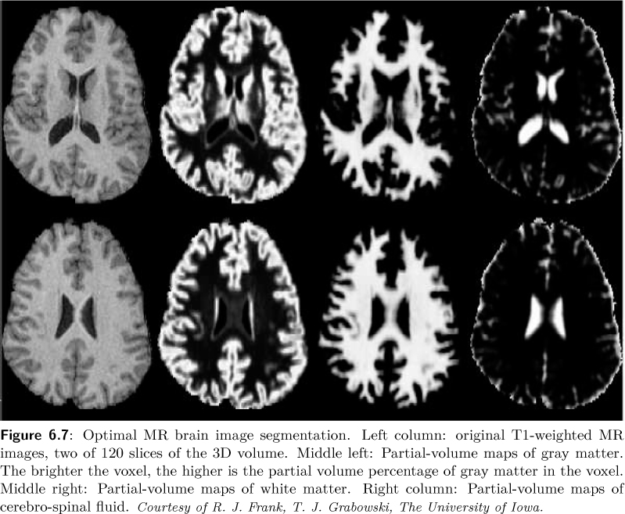
Image Processing, Analysis, and Machine Vision, 4th Edition Sonka, Hlavac & Boyle

Slide 20
Multi-spectral thresholding
Image Processing, Analysis, and Machine Vision, 4th Edition Sonka, Hlavac & Boyle
Multi-spectral images
Many practical segmentation problems need more information than is contained in one spectral band.
For example, color images, multi-spectral remote sensing images…
Algorithm 6.3 Recursive multi-spectral thresholding
1. Initialize the whole image as a single region.
2. Compute a smoothed histogram for each spectral band.
Find the most significant peak in each histogram and determine two thresholds as local minima on either side of this maximum.
Segment each region in each spectral band into subregions according to these thresholds.
Each segmentation in each spectral band is projected into a multi-spectral segmentation (see Figure 6.8).
Regions for the next processing steps are those in the multi-spectral image.
3. Repeat step 2 for each region of the image until each region’s histogram contains only one significant peak.

Slide 21
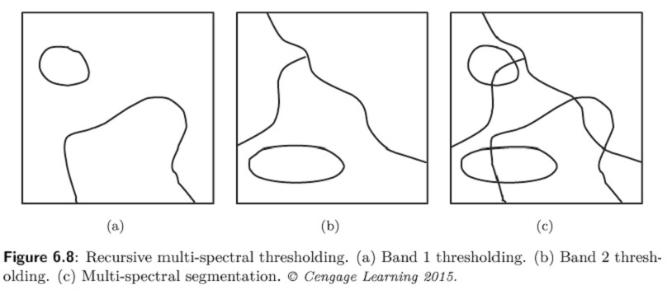
Multi-spectral thresholding
Image Processing, Analysis, and Machine Vision, 4th Edition Sonka, Hlavac & Boyle
An example of multi-spectral thresholding

Slide 22
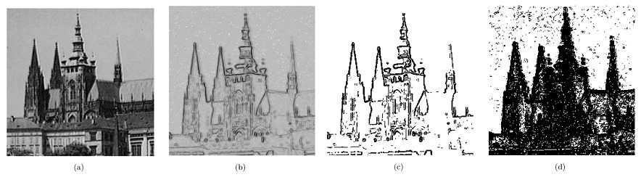
Edge-based segmentation
Image Processing, Analysis, and Machine Vision, 4th Edition Sonka, Hlavac & Boyle
Edge image thresholding
In an edge image, almost no zero-value pixels are present.
Simple thresholding of an edge image can be applied to remove these small valued.
Original image
Edge image
Threshold 30
Threshold 10

Slide 23
Edge-based segmentation
Image Processing, Analysis, and Machine Vision, 4th Edition Sonka, Hlavac & Boyle
Non-maximal suppression (used by Canny edge detection)
A problem with simple edge detectors is the thickening.
Non-maximal suppression can suppress multiple responses in the neighborhood of single boundaries. (thinning)
Algorithm 6.4 Non-maximal suppression of directional edge data
1. Quantize edge directions eight ways according to 8-connectivity.
2. For each pixel with non-zero edge magnitude, inspect the two adjacent pixels indicated by the direction of its edge. (see Figure 6.10)
3. If the edge magnitude of either of these two exceeds that of the pixel under inspection, mark it for deletion.
4. When all pixels have been inspected, re-scan the image and erase to zero all edge data marked for deletion.

Slide 24
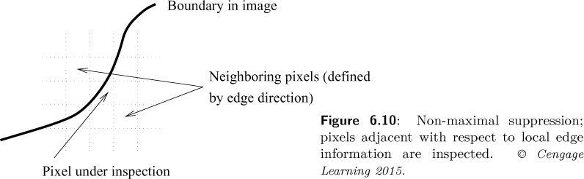
Edge-based segmentation
Image Processing, Analysis, and Machine Vision, 4th Edition Sonka, Hlavac & Boyle
Algorithm 6.4 Non-maximal suppression of directional edge data
2. For each pixel with non-zero edge magnitude, inspect the two adjacent pixels indicated by the direction of its edge. (see Figure 6.10)

Slide 25
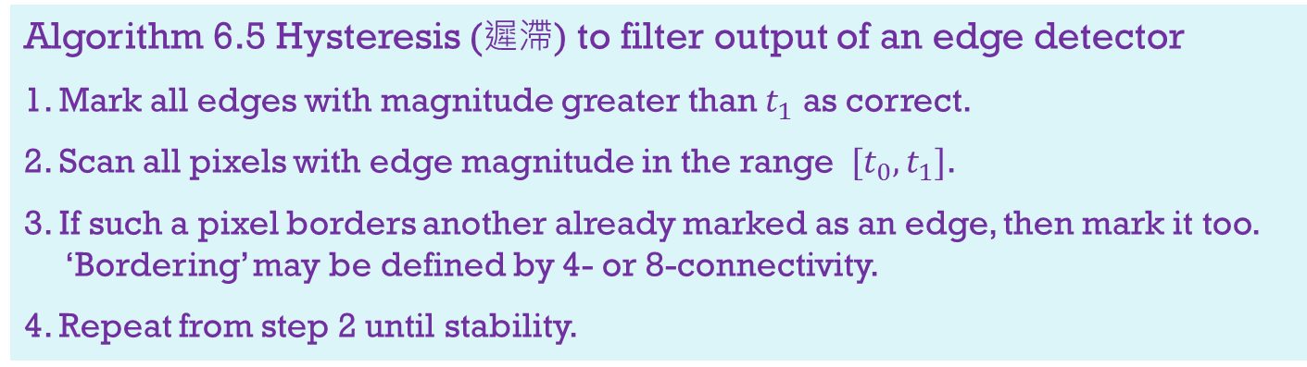
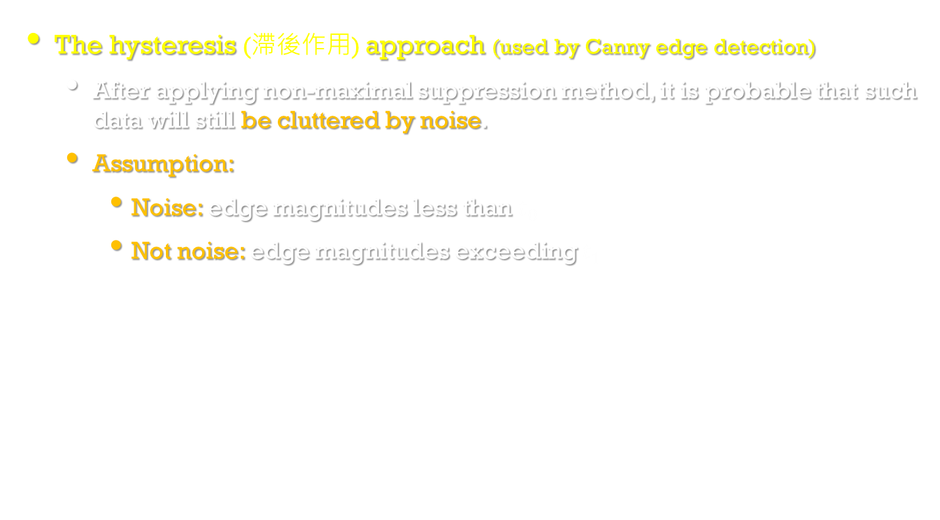
Edge-based segmentation
Image Processing, Analysis, and Machine Vision, 4th Edition Sonka, Hlavac & Boyle
The hysteresis (滯後作用) approach (used by Canny edge detection)
After applying non-maximal suppression method, it is probable that such data will still be cluttered by noise.
Assumption:
Noise: edge magnitudes less than $t_{0}$
Not noise: edge magnitudes exceeding $t_{1}$
Algorithm 6.5 Hysteresis (遲滯) to filter output of an edge detector
1. Mark all edges with magnitude greater than $t_{1}$ as correct.
2. Scan all pixels with edge magnitude in the range $[t_{0},t_{1}]$.
3. If such a pixel borders another already marked as an edge, then mark it too. ‘Bordering’ may be defined by 4- or 8-connectivity.
4. Repeat from step 2 until stability.

Slide 26
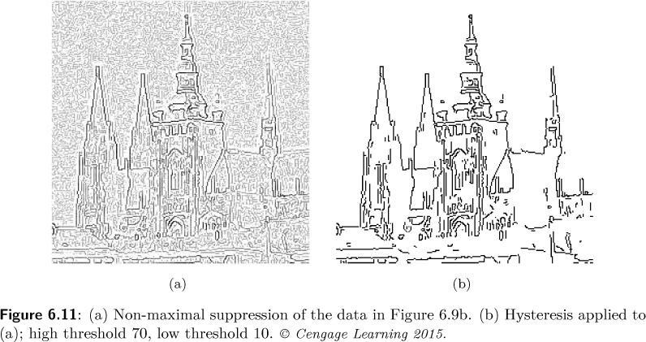
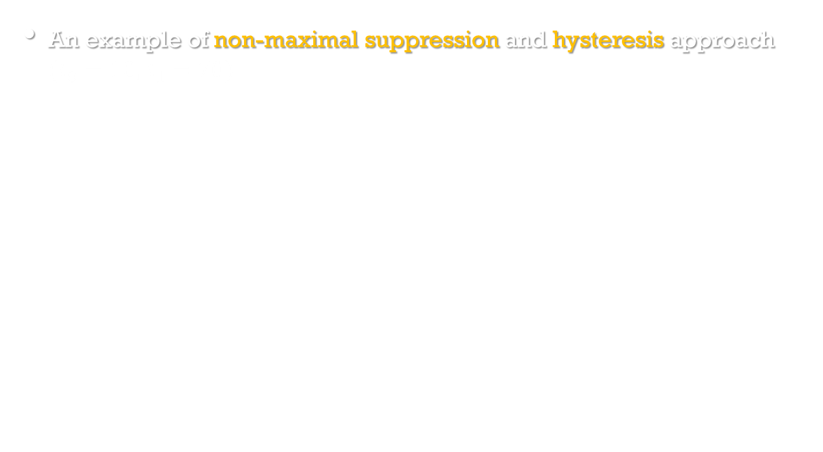
Edge-based segmentation
Image Processing, Analysis, and Machine Vision, 4th Edition Sonka, Hlavac & Boyle
An example of non-maximal suppression and hysteresis approach $(t_{0}=10;t_{1}=70)$

Slide 27
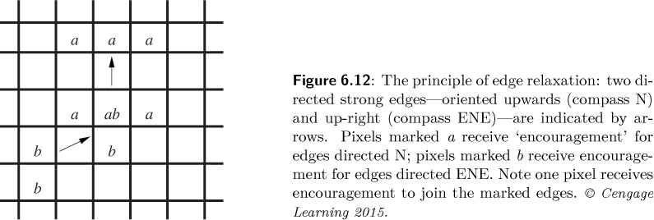
Edge relaxation
Image Processing, Analysis, and Machine Vision, 4th Edition Sonka, Hlavac & Boyle
The output of an edge detector is considered as an initialization.
Iteratively, pixel connected to strong edge responses are viewed as ‘likely’ to be edges themselves, while strong responses isolated from any others are viewed as less likely.
This idea updates edge responses, and is iterated until some convergence is reached.

Slide 28
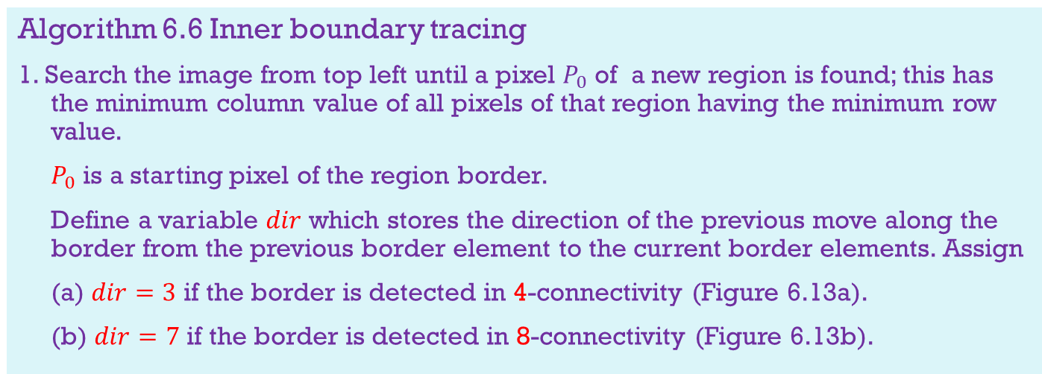
Border tracing
Image Processing, Analysis, and Machine Vision, 4th Edition Sonka, Hlavac & Boyle
If a region border is not known but regions have been defined in the image, border can be detected uniquely.
An inner region border is a subset of the region.
The outer border is not a subset of the region.
Algorithm 6.6 Inner boundary tracing
1. Search the image from top left until a pixel $P_{0}$ of a new region is found; this has the minimum column value of all pixels of that region having the minimum row value.
$P_{0}$ is a starting pixel of the region border.
Define a variable $dir$ which stores the direction of the previous move along the border from the previous border element to the current border elements. Assign
(a) $dir=3$ if the border is detected in 4-connectivity (Figure 6.13a).
(b) $dir=7$ if the border is detected in 8-connectivity (Figure 6.13b).

Slide 29
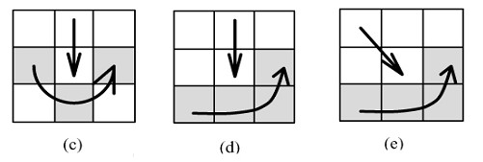
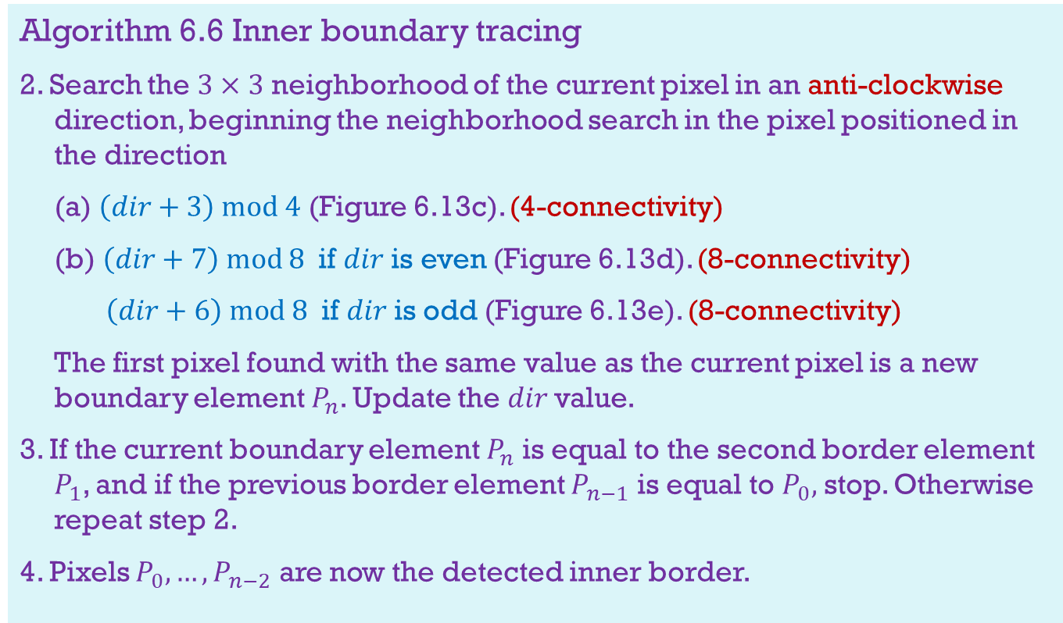
Image Processing, Analysis, and Machine Vision, 4th Edition Sonka, Hlavac & Boyle
Algorithm 6.6 Inner boundary tracing
2. Search the $3×3$ neighborhood of the current pixel in an anti-clockwise direction, beginning the neighborhood search in the pixel positioned in the direction
(a) $\left(dir+3\right) mod 4$ (Figure 6.13c). (4-connectivity)
(b) $\left(dir+7\right) mod 8$ if $dir$ is even (Figure 6.13d). (8-connectivity)
$\left(dir+6\right) mod 8$ if $dir$ is odd (Figure 6.13e). (8-connectivity)
The first pixel found with the same value as the current pixel is a new boundary element $P_{n}$. Update the $dir$value.
3. If the current boundary element $P_{n}$ is equal to the second border element $P_{1}$, and if the previous border element $P_{n−1}$ is equal to $P_{0},$ stop. Otherwise repeat step 2.
4. Pixels $P_{0},…,P_{n−2}$ are now the detected inner border.

Slide 30
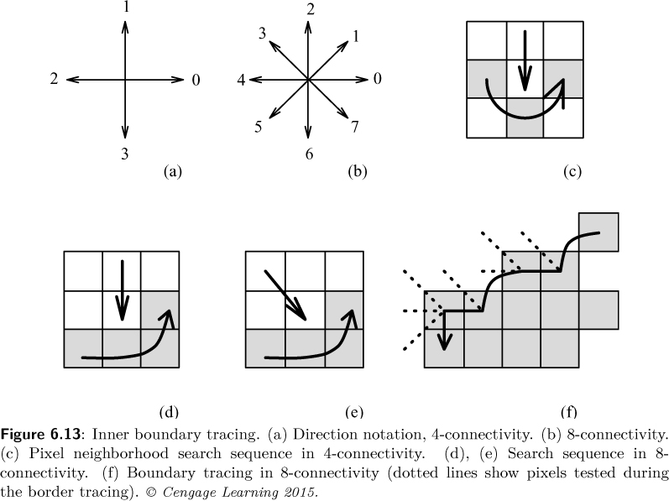
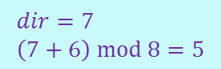
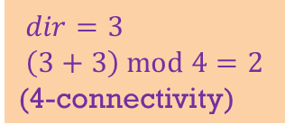
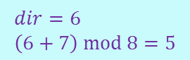



Border tracing
Image Processing, Analysis, and Machine Vision, 4th Edition Sonka, Hlavac & Boyle
$$dir=3 \\ \left(3+3\right) mod 4=2$$
(4-connectivity)
$$2$$
$$0$$
$$3$$
$$dir=6 \\ \left(6+7\right) mod 8=5$$
$$dir=7 \\ \left(7+6\right) mod 8=5$$

Slide 31

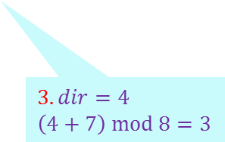


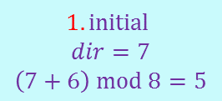
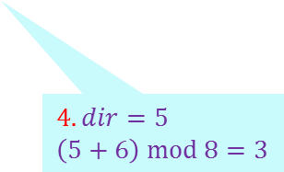
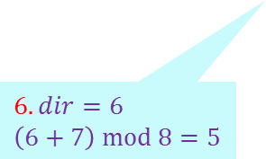
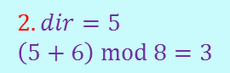

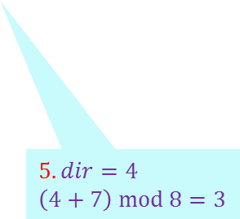

Border tracing
Image Processing, Analysis, and Machine Vision, 4th Edition Sonka, Hlavac & Boyle
8-connectivity
$\left(dir+7\right) mod 8$ if $dir$ is even.
$\left(dir+6\right) mod 8$ if $dir$ is odd.
$$1. initial$$
$$dir=7$$
$$\left(7+6\right) mod 8=5$$
$$3$$
$$3$$
$$3$$
$$3$$
$$2. dir=5 \\ \left(5+6\right) mod 8=3$$
$$3. dir=4$$
$$\left(4+7\right) mod 8=3$$
$$4. dir=5$$
$$\left(5+6\right) mod 8=3$$
$$6. dir=6$$
$$\left(6+7\right) mod 8=5$$
$$5. dir=4$$
$$\left(4+7\right) mod 8=3$$

Slide 32
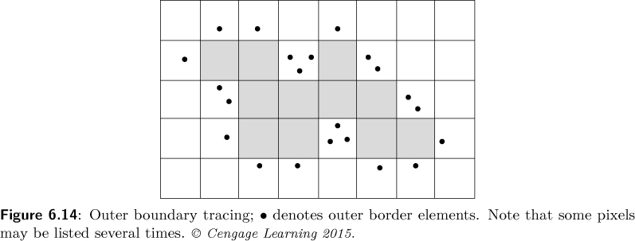
Border tracing
Image Processing, Analysis, and Machine Vision, 4th Edition Sonka, Hlavac & Boyle
Outer boundary tracing
Algorithm 6.7 Outer boundary tracing
1. Trace the inner region boundary in 4-connectivity until done.
2. The outer boundary consists of all non-region pixels that were tested during the search process; if some pixels were tested more than once, they are listed more than once in the outer boundary list.

Slide 33
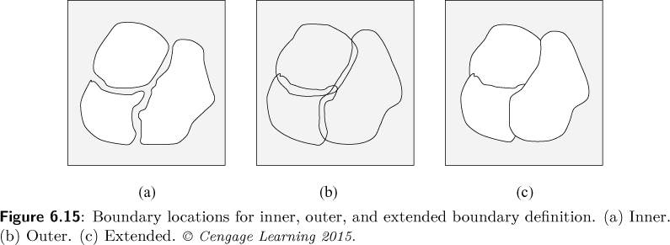
Border tracing
Image Processing, Analysis, and Machine Vision, 4th Edition Sonka, Hlavac & Boyle
The inner border is always part of a region but the outer border never is.
If two regions are adjacent, they never have a common border, which causes difficulties in higher processing levels with region description, region merging, etc.
Extended borders define a single common border between adjacent regions which may be specified using standard pixel co-ordinates.

Slide 34
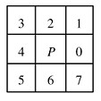
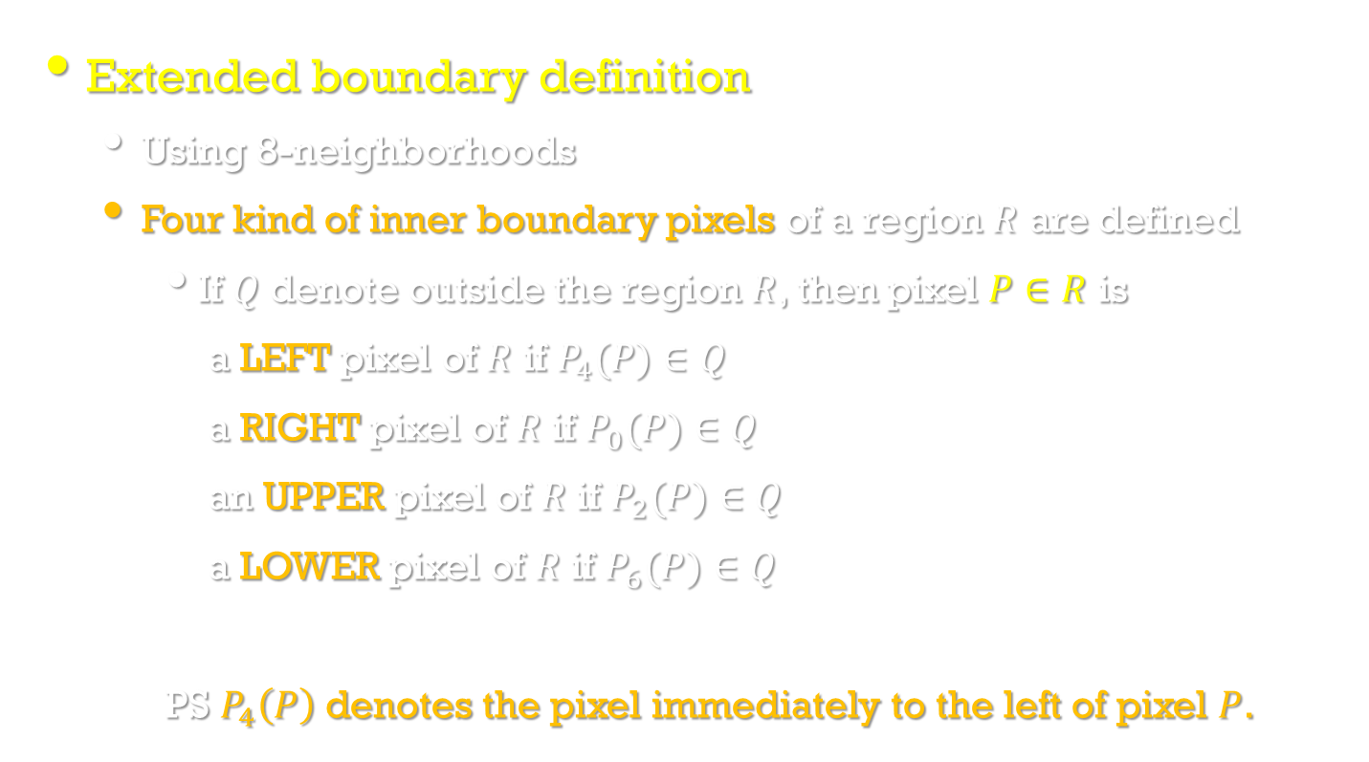
Border tracing
Image Processing, Analysis, and Machine Vision, 4th Edition Sonka, Hlavac & Boyle
Extended boundary definition
Using 8-neighborhoods
Four kind of inner boundary pixels of a region $R$ are defined
If $Q$ denote outside the region $R$, then pixel $P∈R$ is
a LEFT pixel of $R$ if $P_{4}(P)∈Q$
a RIGHT pixel of $R$ if $P_{0}(P)∈Q$
an UPPER pixel of $R$ if $P_{2}(P)∈Q$
a LOWER pixel of $R$ if $P_{6}(P)∈Q$
PS $P_{4}\left(P\right)$ denotes the pixel immediately to the left of pixel $P$.

Slide 35
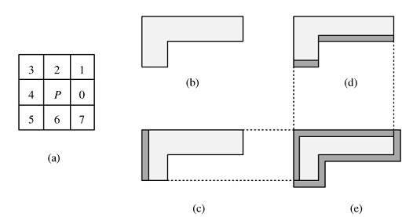
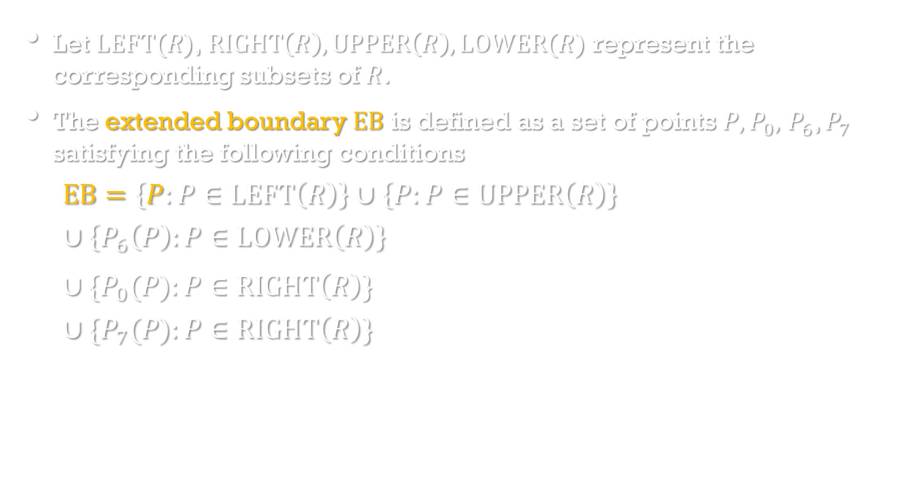
Border tracing
Image Processing, Analysis, and Machine Vision, 4th Edition Sonka, Hlavac & Boyle
Let $LEFT(R)$,$RIGHT\left(R\right),UPPER\left(R\right),LOWER(R)$ represent the corresponding subsets of $R$.
The extended boundary $EB$ is defined as a set of points $P,P_{0},$ $P_{6}$, $P_{7}$ satisfying the following conditions
$$EB=\left\{P:P∈LEFT\left(R\right)\right\}∪\left\{P:P∈UPPER\left(R\right)\right\}$$
$$∪\left\{P_{6}\left(P\right):P∈LOWER\left(R\right)\right\}$$
$∪\{P_{0}(P):P∈RIGHT\left(R\right)\}$
$$∪\{P_{7}(P):P∈RIGHT\left(R\right)\}$$

Slide 36

Border tracing
Image Processing, Analysis, and Machine Vision, 4th Edition Sonka, Hlavac & Boyle
The extended boundary (EB) can easily be constructed from the outer boundary.
Using an intuitive definition of RIGHT, LEFT, UPPER, and LOWER outer boundary points, EB may be obtained by
shifting all the UPPER outer boundary points one pixel down and right,
shifting all the LEFT outer boundary points one pixel to the right, and
shifting all the RIGHT outer boundary points one pixel down.
The LOWER output boundary point positions remain unchanged.

Slide 37


Border tracing
Image Processing, Analysis, and Machine Vision, 4th Edition Sonka, Hlavac & Boyle
A efficient algorithm for extended boundary extractions [Liow,1991]
Note that no hole-border tracing is included in the algorithm.
Algorithm 6.8 Extended boundary tracing
1. Define a starting pixel of an extended boundary in some standard way.
2. The first move along the traced boundary from the starting pixel is in direction $dir=6$ (down), corresponding to the situation (i) in Figure 6.18.
3. Trace the extended boundary using the look-up table in Figure 6.18 until a closed extended border results.
Figure 6.18

Slide 38
Border tracing
Image Processing, Analysis, and Machine Vision, 4th Edition Sonka, Hlavac & Boyle
Border tracing in gray-level images
A more difficult situation is encountered if borders are traced in gray-level images which regions have not yet been defined.
The border is represented by a simple path of high-gradient pixels in the image.
Border tracing is initialized at a pixel with a high probability of being a border element, and then border construction proceeds by adding the next elements which are in the most probable direction.
To find the following border elements, edge gradient magnitudes and directions are usually computed in pixels of probable border continuation.

Slide 39

Border tracing
Image Processing, Analysis, and Machine Vision, 4th Edition Sonka, Hlavac & Boyle
Algorithm 6.9 Border tracing in gray-level images
1. Suppose the border has been determined up to the border element $x_{i}$.
2. Define an element $x_{j}$ as a pixel adjacent to $x_{i}$ in the direction ${φ(x}_{i})$.
If the gradient magnitude in $x_{j}$ is larger than a preset threshold, $x_{j}$ is considered a border element; return to step 1.
3. Compute the average gray-level value in the $3×3$ neighborhood of the pixel $x_{j}$.
Compare the result with some preset gray-level value and decide whether $x_{j}$ is positioned inside or outside the region.
4. Try to continue tracing at pixel $x_{k}$, adjacent to $x_{i}$ in direction $[{φ(x}_{i})±π/4]$, the sign being determined by the result of step 3.
If a continuation is found, $x_{k}$ is a new border element, and return to step 1.
If $x_{k}$ is not a border element, start tracing at another promising pixel.

